Slide 1
Model Selection
Instructor: Hamed Hasheminia
Lecture 6

Slide 2
Agenda
Bias-Variance Trade off
Validation (Test vs Train set)
Cross-Validation
Ridge and Lasso Regression
(Optional) Backward Selection, Forward Selection, All Subset Selection. (If you want to use these methods you need to use R)

Slide 3
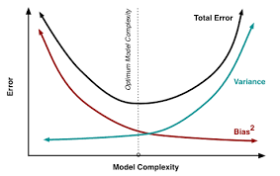
Bias – Variance Trade-off
Notes:
Model complexity more flexible
Best model should have enough flexible

Slide 4
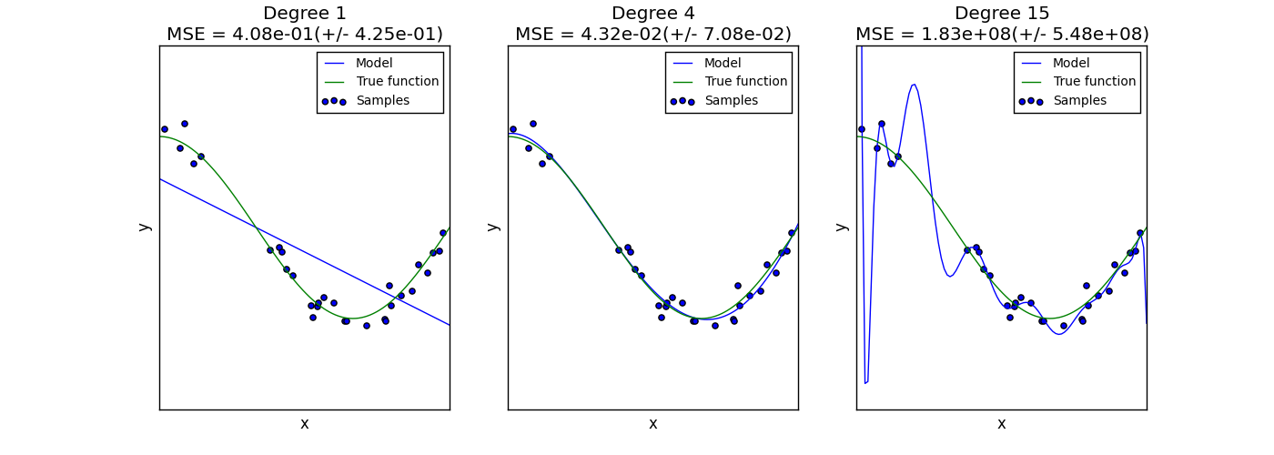
Bias – Variance Trade-off
Notes:
Bias very large in first, totally underfit, the last one is overfit and the variance is up, the middle one is just right.

Slide 5
Validation
We divide our dataset to test and training.
We then train our algorithms with train data.
We compute test error by using predictions of our models on our test set.
Notes:
What percent of data for test? Maybe 10- 20% . Sparse data means that a feature is not say income from 1 to a million, but instead is 100 to 4000 (for instance)

Slide 6
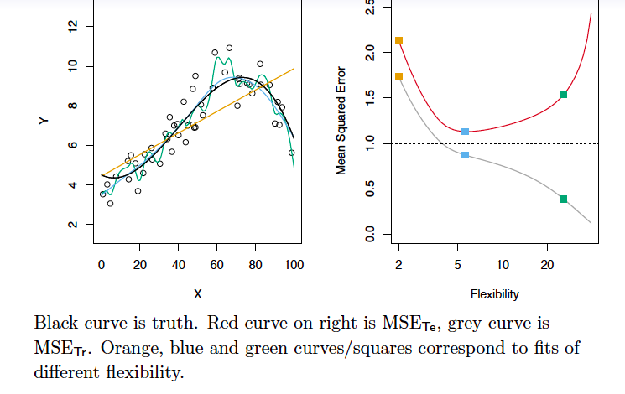
Validation example
Notes:
Right hand graph – upper line is error on test set, gray line is on training set . You can see that as the model becomes more flexible, the errors on the training set go down, but at the same time they increase on the test data because of overfitting. Where the blue dot is marks a happy point for model selection, because the test data error is at a low point.

Slide 7
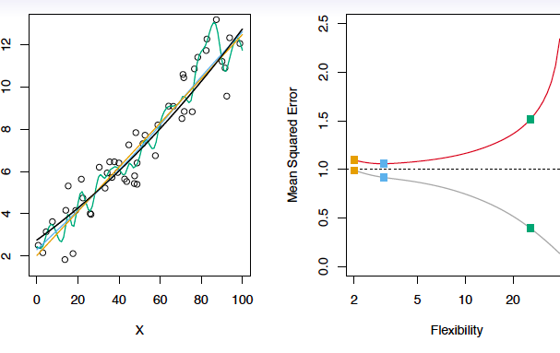
Validation Example
Notes:
In this case depicted, the real model is a really a line. So the less flexible model is the most successful.
When you have a polynomial of a higher degree the confidence interval becomes very wide at the tails – don’t go with polynomials above degree 4

Slide 8
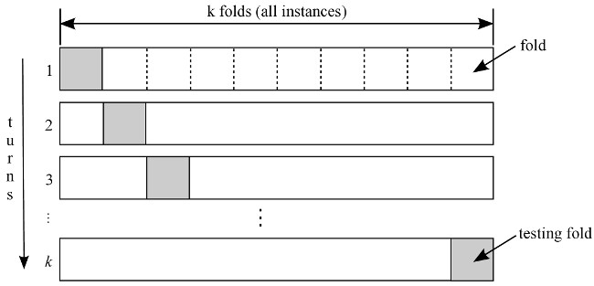
K-fold Cross-Validation
Notes:
When you have a small number of observations -- most used is 5-fold and 10-fold (why?)
Divide dataset into k subsets of randomly selected observations.
Use validation when you have enough data because when using cross validation the errors can be low because the models share data

Slide 9
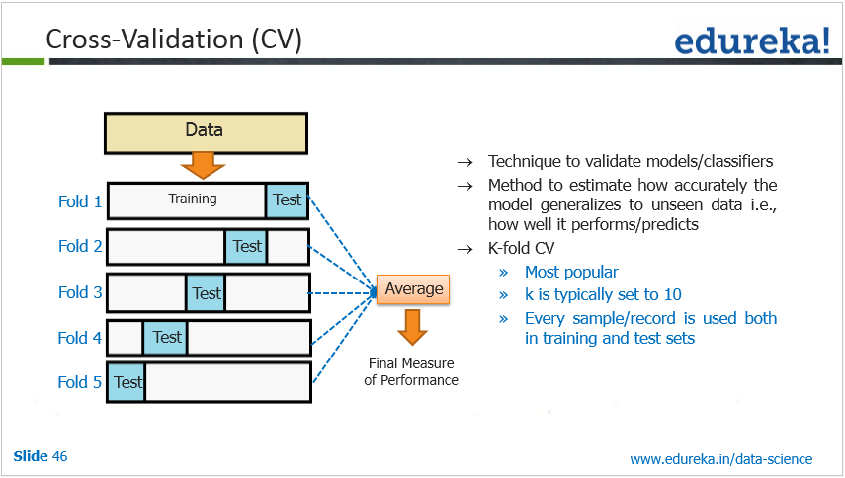
K-fold Cross-Validation
Notes:
So on first go, train on 80% and test on 20%
Take next fold, train on 80% and test on 20%

Slide 10
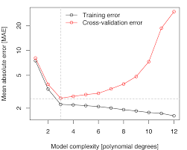
Notes:
Simpler is better, he changed the line so that the orange point at 4 was lower, closer to gray, but he said not enough incremental value increase so stick with previous model

Slide 11
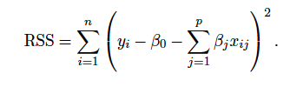

Ridge Regression (Shrinkage method)
In ridge regression we penalize our model for adding more variables:
Lambda > 0, is a tuning parameter. We set it by cross-validation
Notes:
With linear model we are trying to minimize our error sum of squares. Flexibility is equivalent to more features.
With any observation with p variables, try to minimize prediction error from reality
Why use this? To determine the best features to use in the model ???????? And how to pick lamda? When lamda goes up flexibility goes down, when lambda goes down flexibilty goes up

Slide 12

Ridge Regression
Coefficients in Ridge Regression are sensitive to scale of your data. It is highly recommended that you standardize your data before performing Ridge Regression. One way to standardize your data is dividing it by its standard deviation. The other way, is chaining it to z-values.

Slide 13
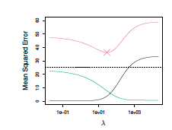
Bias-Variance Trade-off in choosing the best lambda
Notes:
Each time you change lambda run cross validation, pink line is error. By changing lambda, this will reduce number of variables.

Slide 14

Lasso Regression
Lasso is very similar to Ridge regression. The only difference is it penalizes objective function with Norm 1 – summation of absolute values - instead of Norm 2.
As in Ridge regression, selecting a good lambda for the lasso is critical; cross-validation is again the method of choice.

Slide 15
Lasso Regression
As with ridge regression, the lasso shrinks the coefficient estimates towards zero.
However, in the case of the lasso, the Norm 1 penalty has the effect of forcing some of the coefficient estimates to be exactly equal to zero when the tuning parameter lambda is sufficiently large.
Notes:
Better than ridge, Lasso is always preferred . But ridge regression is computationally easier because of squares vs absolute values (who would think?)
Lasso regression will reduce betas to zero as they become insignificant.

Slide 16
Other methods of model selection
Forward Selection (Python is not that good for this method)
Backward selection(Python is not that good for this method)
All subset selection(Python is not that good for this method)
Principle component methods. (Will cover that later in the course.)

Slide 17
Summary
Bias-Variance Trade-off
Validation
Cross-Validation
Ridge-Regression
Lasso-Regression
Backward, Forward, and all subset selection
Resource (Chapter 6): http://www-bcf.usc.edu/~gareth/ISL/data.html
Video Resource: http://dataminingclass.com/index.php/lectures/linear-model-selection-and-regularization/

